Slide 1



Alain "Lino" Tadros is a partner architect at Solliance on AI, Machine Learning and IoT for the last 4 years.
Lino provides world-class consulting, training, and software development for small, medium, and enterprise level businesses. Lino started his career in 1990 as a well-respected member of the development team at Borland for Delphi and C++Builder.
He has been awarded Microsoft MVP status 15 years in a row for his numerous contributions to the C# community and currently is recognized as a Microsoft Regional Director. Lino is also an expert in AI & Machine Learning, IoT, .NET, Azure, ASP.NET, MVC, iOS, Android, Xamarin, Sitefinity and many testing solutions.
Lino is an industry renowned speaker and has given numerous presentations in 53 countries since 1994. He currently sits on the Board of Directors of 4 Silicon Valley corporations.
You can regularly catch Lino on his LiveStream on Twitch at https://twitch.tv/linotadros
Lino Tadros
Cloud Solutions Architect
lino@solliance.net

Slide 2
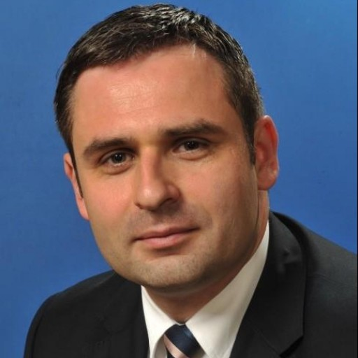
Ciprian Jichici is the Chief Data Scientist of Solliance, one of the top worldwide Microsoft AI partners.
He is recognized internationally as a Microsoft Regional Director and a Microsoft Most Valuable Professional for Artificial Intelligence and Quantum Computing.
Cloud Computing, Artificial Intelligence, and Machine Learning are some of the key areas of his expertise spanning 20+ years of IT.
Ciprian is also very passionate about quantum physics and consequently, about quantum computing.
Ciprian Jichici
Chief Data Scientist
ciprian@solliance.net

Slide 3
“
Today we don’t think of aviation as ‘artificial flight’—it’s simply flight. In the same way, we shouldn’t think of technological intelligence as artificial, but rather as intelligence that serves to augment human capabilities and capacities.
”
Satya Nadella, Hit Refresh

Slide 4
Categorizing Data By how we work with it
Operational data
Analytical data
Streaming data
Read/write data used by applications to keep current state
Examples: Order info in an ecommerce application, customer info in a CRM application
Read-only historical data used for analysis
Examples: Data warehouses, machine learning data
Data produced and processed in real time
Examples: Internet of Things (IoT), e.g., sensor data

Slide 5
Lambda architecture
Speed Layer
Input Data
Analytics Client
Real-Time Views
“Hot” Path
Batch Layer
Serving Layer
Master Data
Batch Views
“Cold” Path

Slide 6
Key Data Architectures
Modern DW
“We want to incorporate all of our data including ‘big data’ with our data warehouse”
Advanced Analytics
“We are trying to predict when our customers churn.”
Stream Analytics
“We are trying to get insights from our devices in real-time, etc.”

Slide 7
Fundamental Services

Slide 8
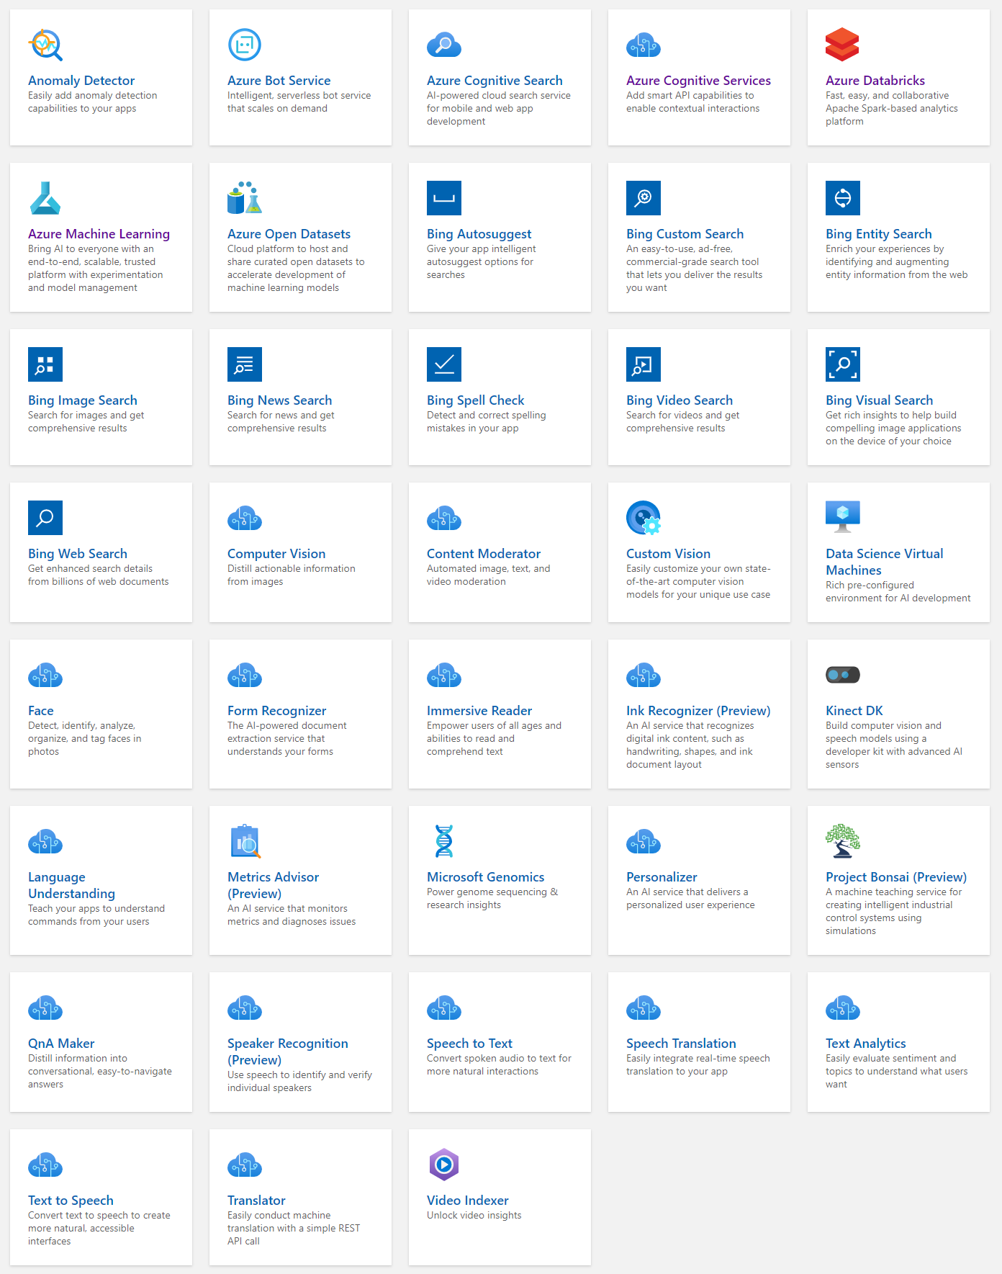
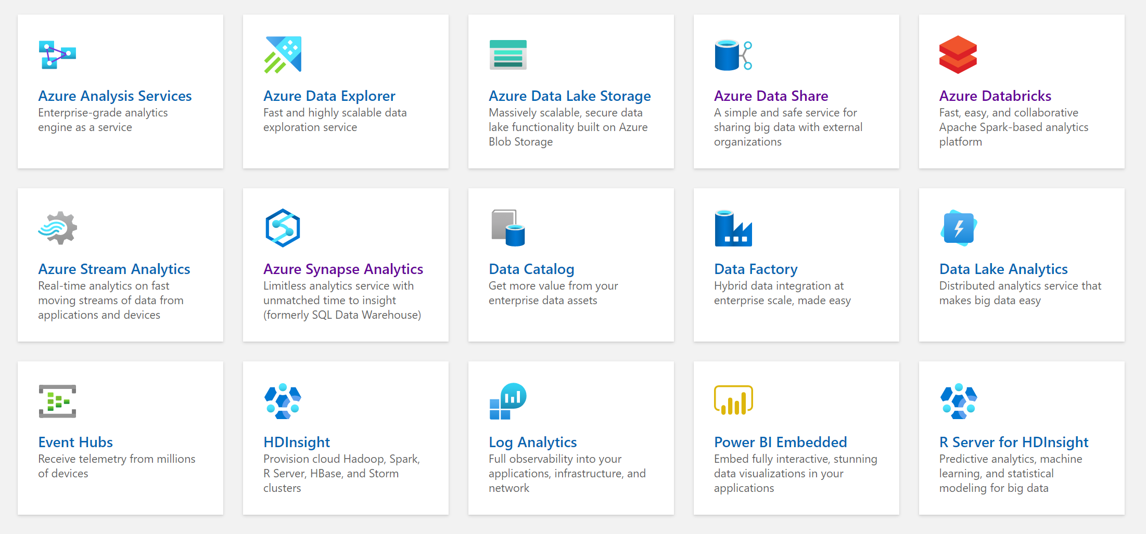
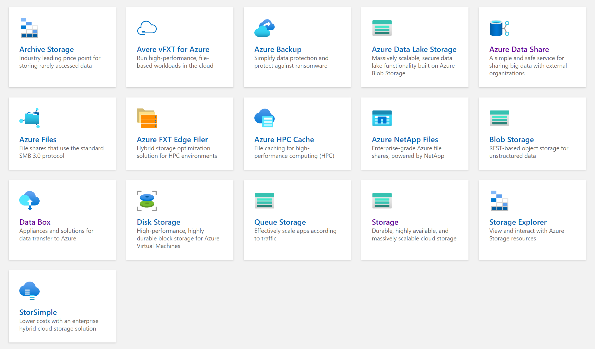
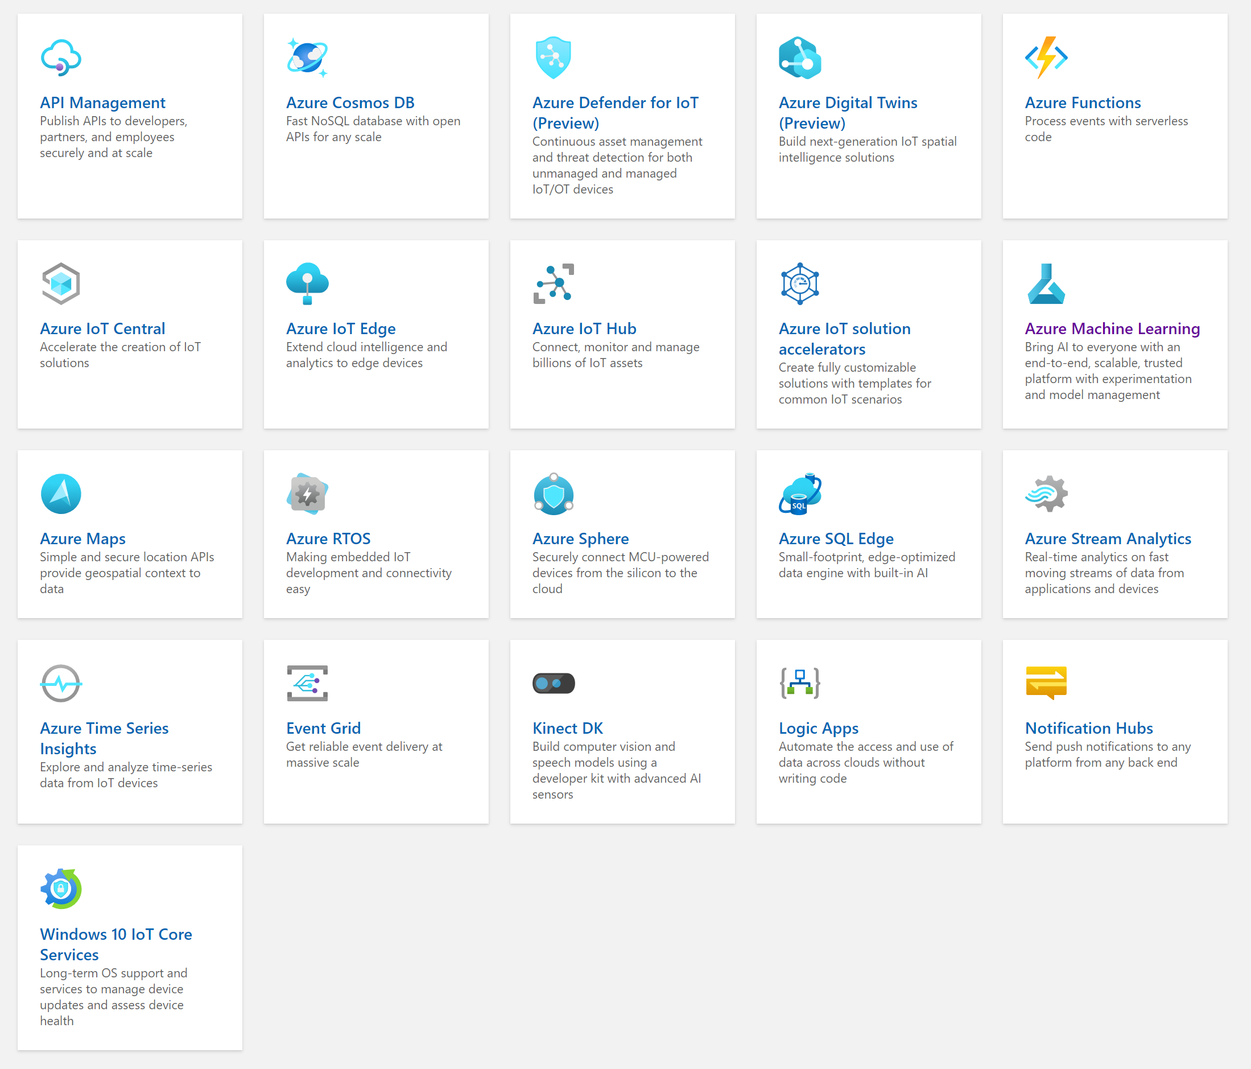
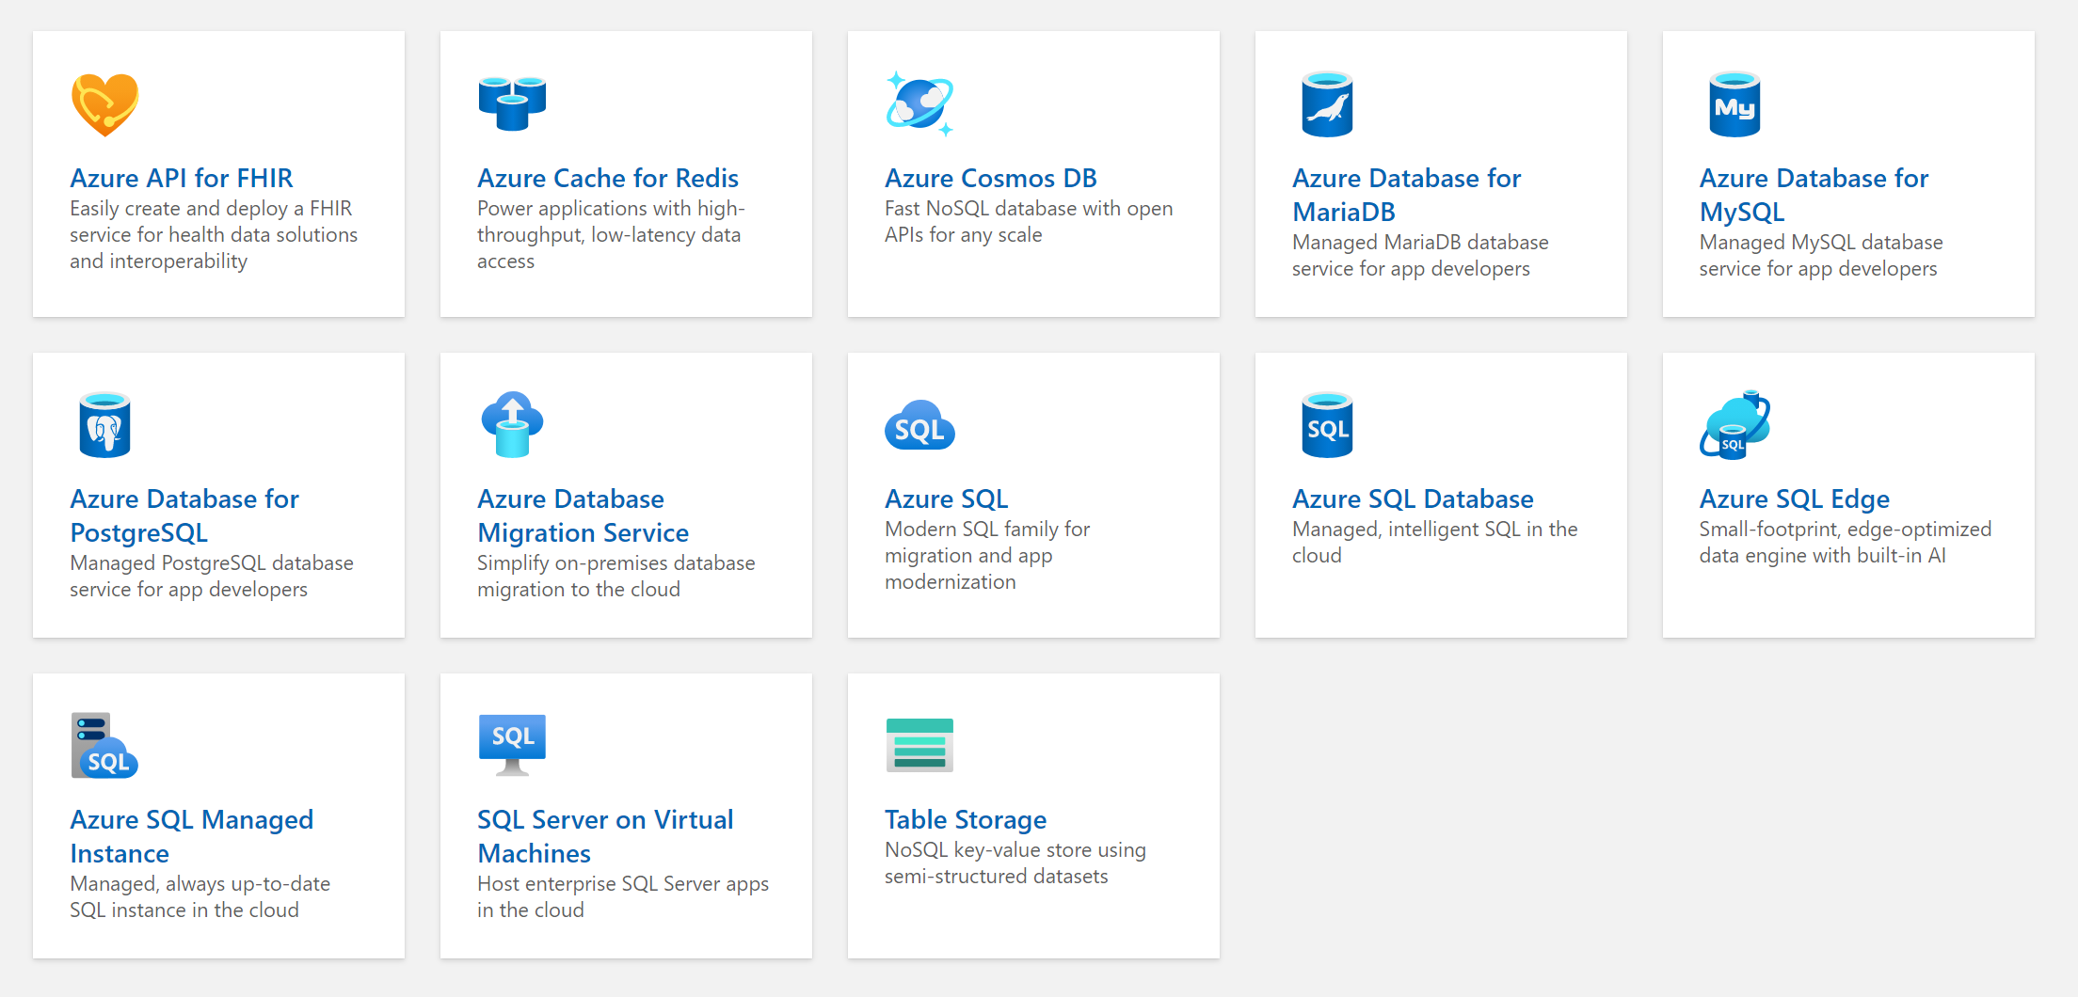
Databases
AI + Machine Learning
Analytics
Storage
IoT

Slide 9
Analytics

Slide 10
Modern Data Warehouse
INGEST
PREPARE
TRANSFORM & ENRICH
SERVE
VISUALIZE
STORE

Slide 11
Apache Spark
A unified, open source, parallel, data processing framework for Big Data Analytics
Spark Unifies:
Batch Processing
Interactive SQL
Real-time processing
Machine Learning
Deep Learning
Graph Processing
Spark SQL
Batch processing
Spark ML/MLlib
Machine Learning
Spark Streaming
Stream processing
GraphX
Graph Computation
Spark Core Engine
Yarn
Spark MLlib
Machine Learning
Spark Structured Streaming
Stream processing
http://spark.apache.org
Notes:
Spark SQL
Unified data access: Query structured data sets with SQL or DataFrame APIs
Fast, familiar query language across all your enterprise data
Use BI tools to connect and query via JDBC or ODBC drivers
MLlib & SparkML
Predictive and prescriptive analytics
Machine learning algorithms for:
Clustering
Classification
Regression
etc.
Smart application design from pre-built, out-of-the-box statistical and algorithmic models
Spark Streaming
Micro-batch event processing for near-real time analytics
e.g. Internet of Things (IoT) devices, Twitter feeds, Kafka (event hub), etc.
Spark’s engine drives some action or outputs data in batches to various data stores
GraphX
Represent and analyze systems represented by graph nodes
Trace interconnections between graph nodes
Applicable to use cases in transportation, telecommunications, road networks, modeling personal relationships, social media, etc.

Slide 12
Artificial Intelligence & Machine Learning

Slide 13
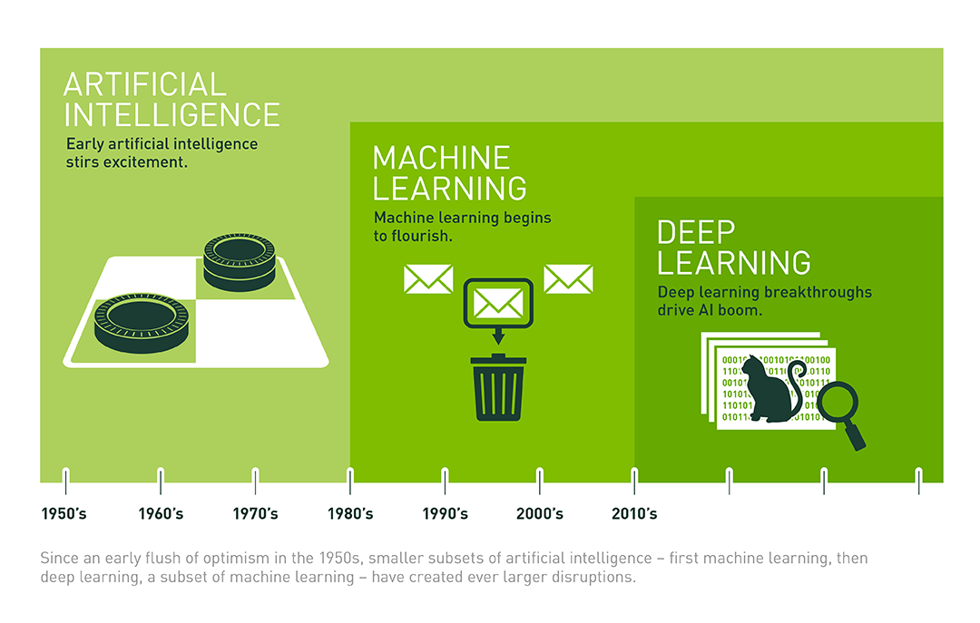
Image credit: https://developer.nvidia.com/deep-learning

Slide 14
The Pre-Built and Custom AI Spectrum
Pre-Built AI
Custom AI
Azure Cognitive Services
Azure Machine Learning
Pre-built models
Custom models
Models are pre-trained using Microsoft supplied data
Models “customized” with your data
Models tailored to your scenario and your data

Slide 15
IoT

Slide 16
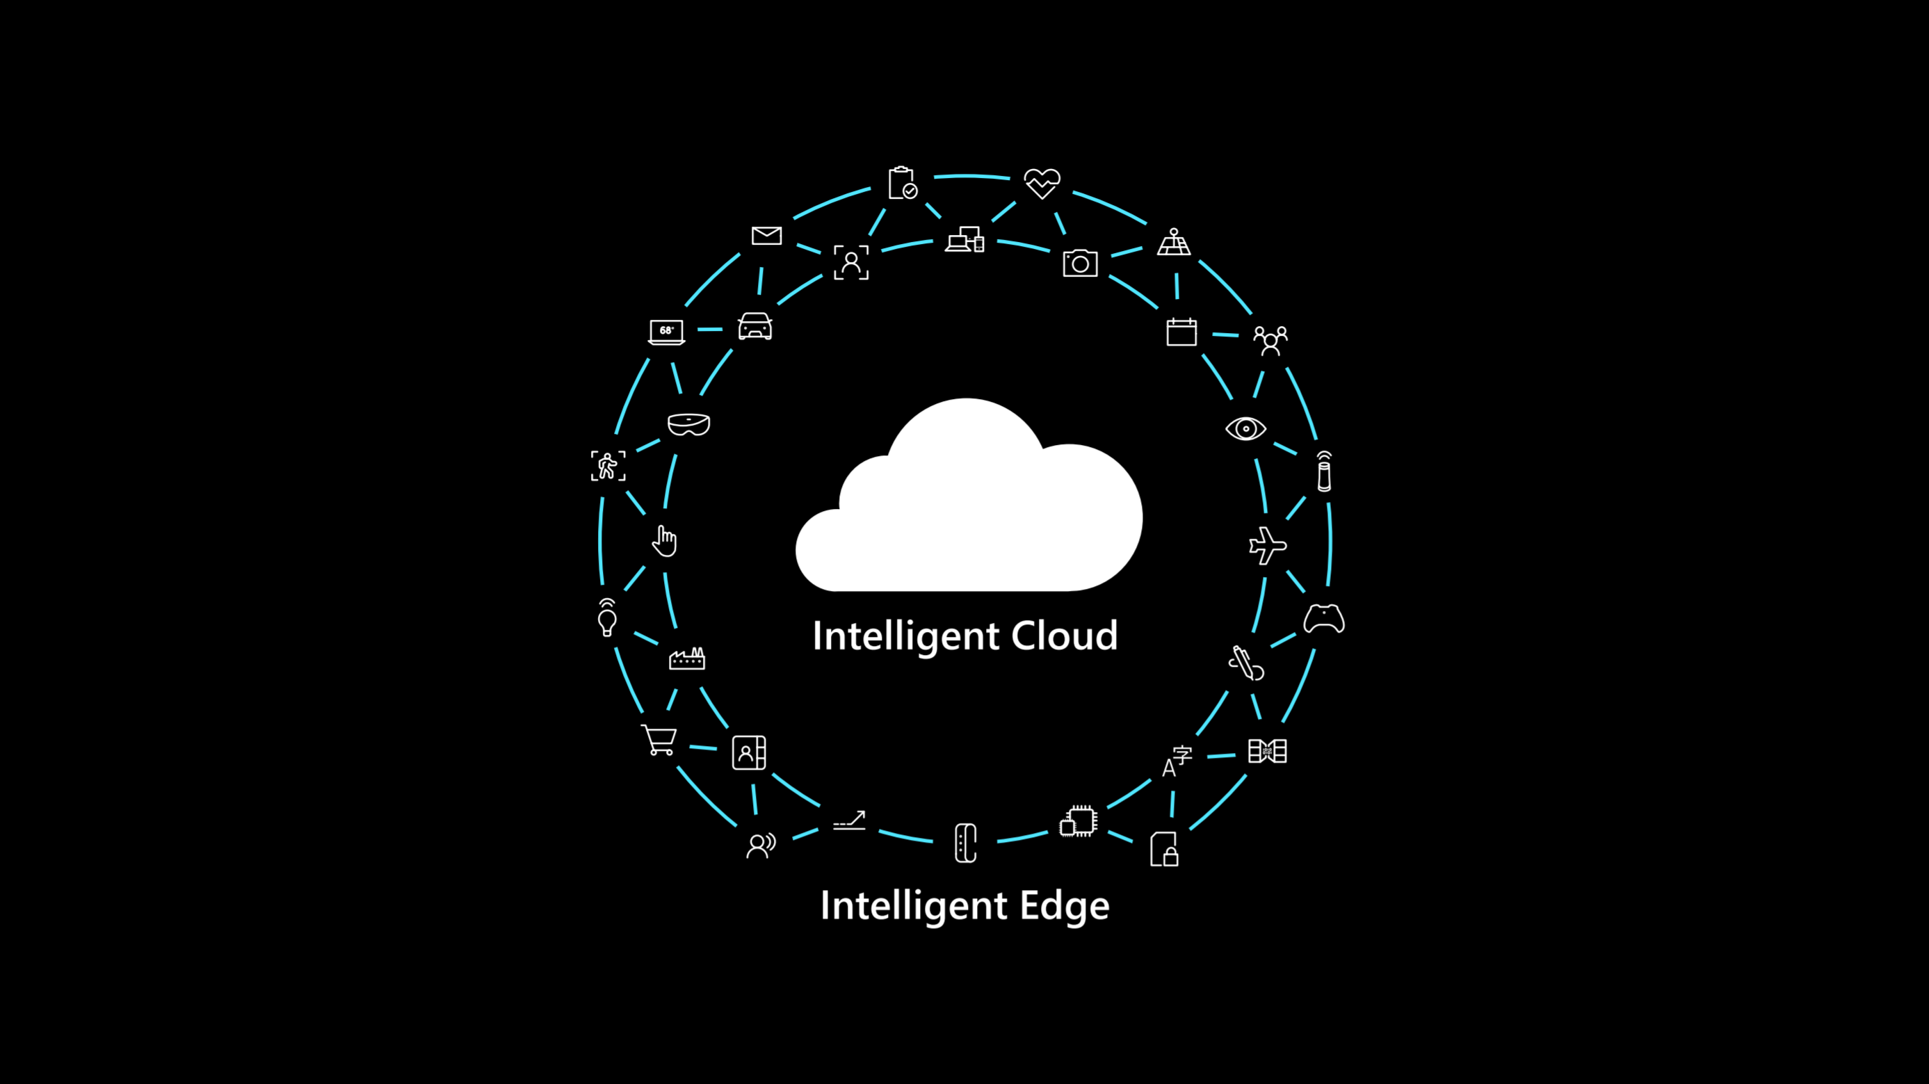
Crossing the chasm

Slide 17
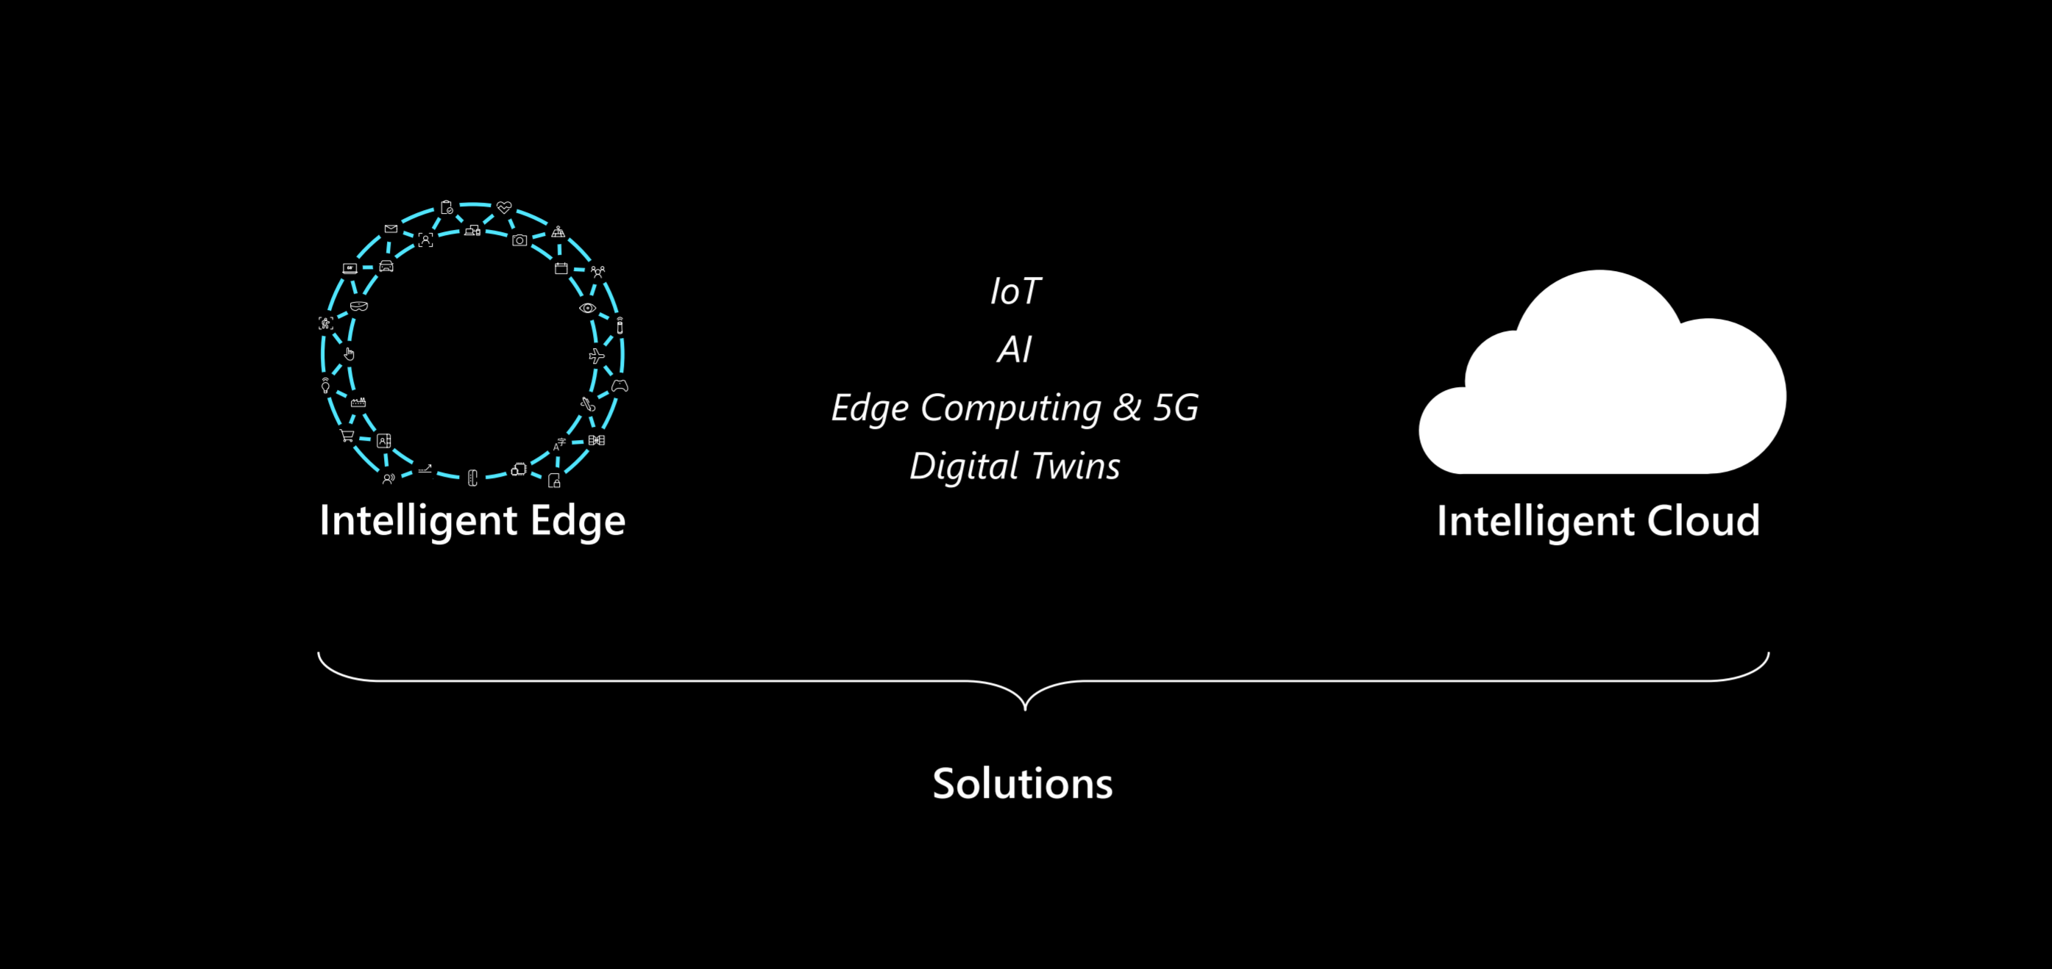
Solutions that span edge to cloud

Slide 18
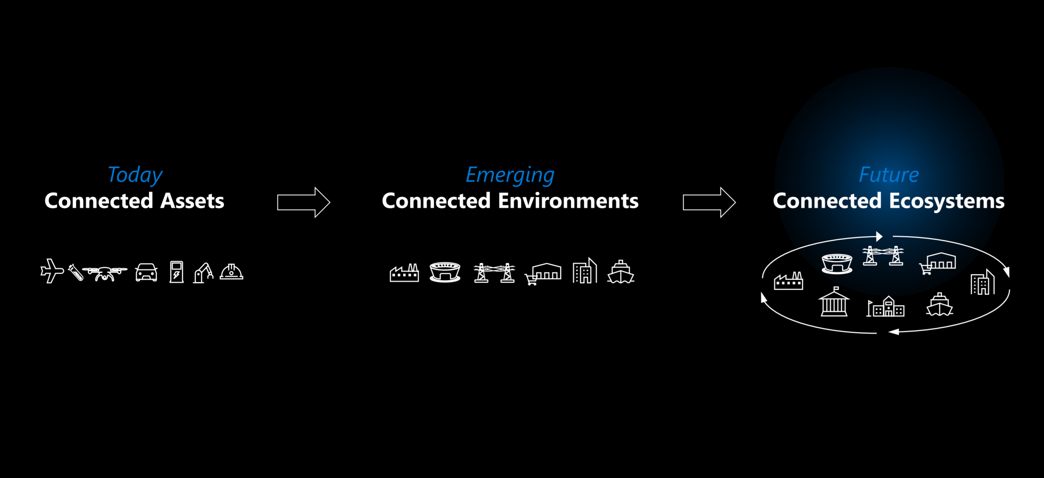
The evolution of connected solutions

